Slide 1
Circuit designing on breadboard, and PCB etching

Slide 2
TEAM MEMBERS
Manan Tamboli(201806100110025)
Vikash Rajpurohit(201806100110079)
Pooja Maldikar(201806100110080)
Riddhi Sukhadiya(201806100110092)

Slide 3
AGENDA
Introduction on breadboard
Why to use breadboard?
Anatomy of breadboard
Build a simple LED Circuit
Breadboard: GuideLines and Tips
Introduction on PCB
Types of PCB
PCB Manufacturing steps
Etching
Difference between BreadBoard and PCB
Suitability

Slide 4
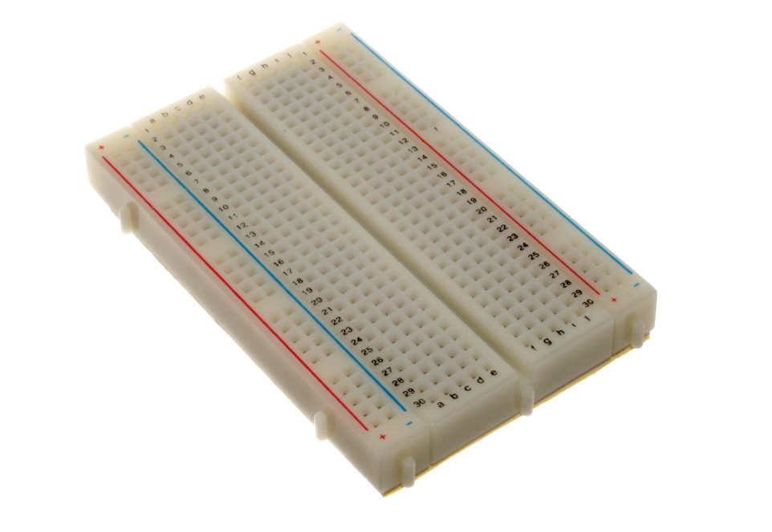
Introduction on breadboard
A breadboard is a solderless construction base used for developing an electronic circuit and wiring for projects with microcontroller boards like Arduino.
The term “Breadboard” comes from a literal piece of wood used to cut bread,
which back in the early
days, people would build
electronic circuits on it.
Sometimes called a
protoboard.

Slide 5
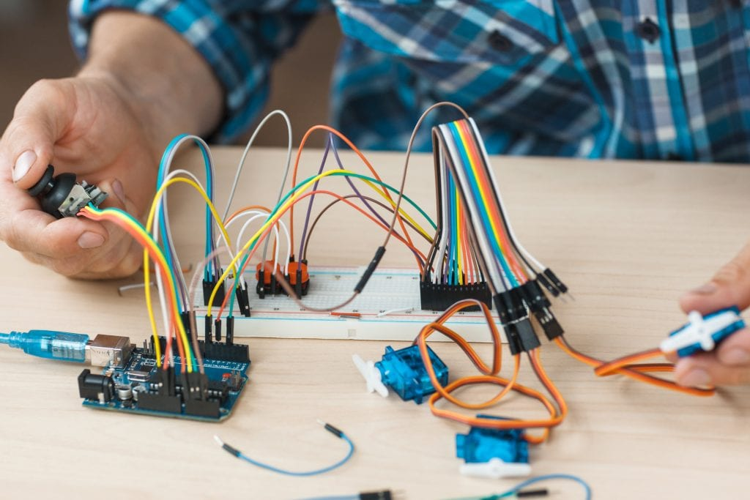
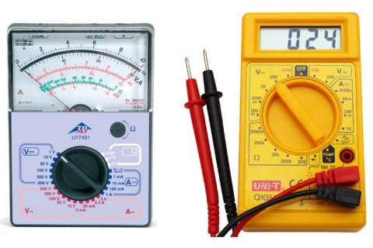
Why to use breadboard
As a complement to circuit simulation, breadboarding allows designers to observe how, and if, the actual circuit functions.
It gives designers the ability to quickly change components during development and testing.
Breadboards allow designers to easily modify a circuit to facilitate measurements of voltage, current, or resistance without soldering.

Slide 6
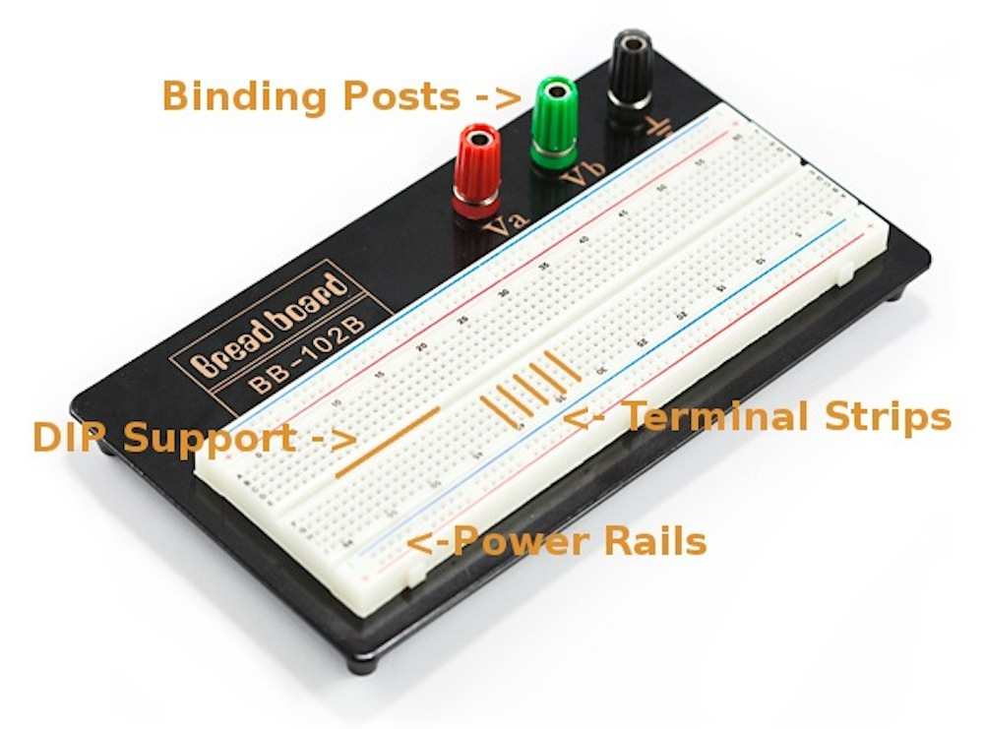
Anatomy of breadboard

Slide 7
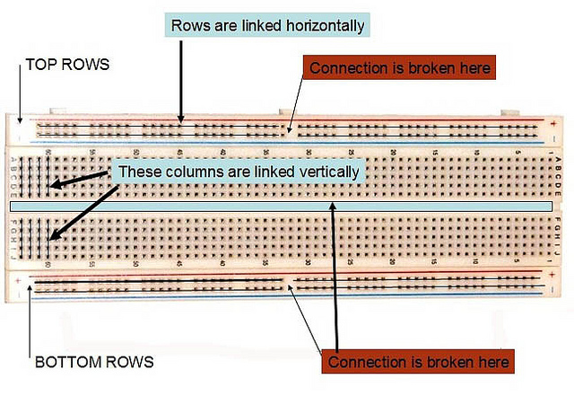
Anatomy of breadboard

Slide 8
Establishing a breadboard circuit connection
Step 1: Connect one of the power supply terminals to a hole of any section on the breadboard
Step 2: Connect one terminal of a resistor to the hole of that section such that both devices are connected to each other
Step 3: Take another resistor and connect it to the hole of another section. Connect the second power supply terminal to that same hole

Slide 9
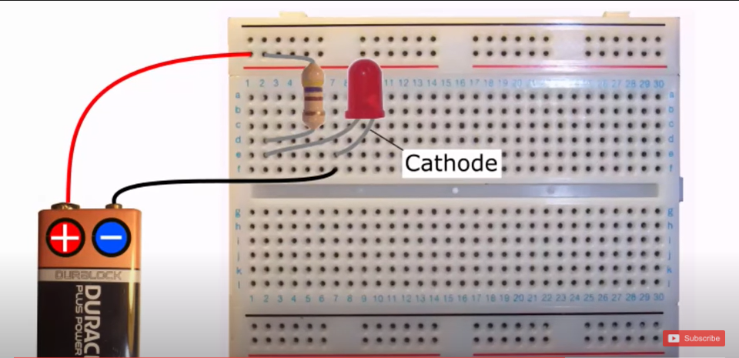
Build simple LED Circuit
[Reference]

Slide 10
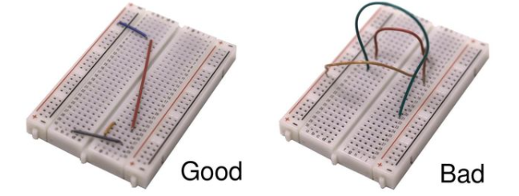
Breadboard: GuideLines and Tips
Use as few jumper wires as possible. Internal breadboard strips should make the majority of connections.
Keep jumper wires as short as possible to avoid jumbled wires which are difficult to troubleshoot.
Breadboard circuit closely to layout of the schematic circuit to aid troubleshooting.

Slide 11
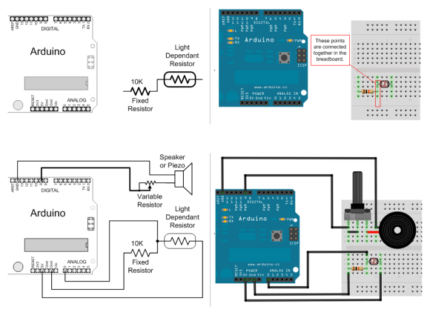
Breadboard: GuideLines and Tips
Use schematic and check off component and wires as added to breadboard.
Cut component leads to short lengths to avoid contact and shorts.
Have someone check the circuit for errors.

Slide 12
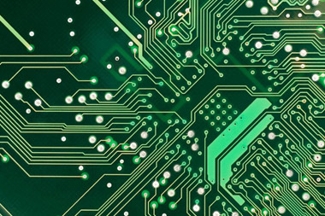
Introduction on PCB
A printed circuit board(PCB) mechanically supports and electrically connects the electronic components using conductive tracks, pads and other features etched from copper sheets laminated onto a non-conductive substrate.
PCBs can be single sided (one copper layer), double sided (two copper layer) or multi- layer.
Advanced PCBs may contain components – capacitors , resistors or active devices – embedded in the substrate.

Slide 13
Types of PCB
Single side PCB
Double side PCB
Multi side PCB

Slide 14
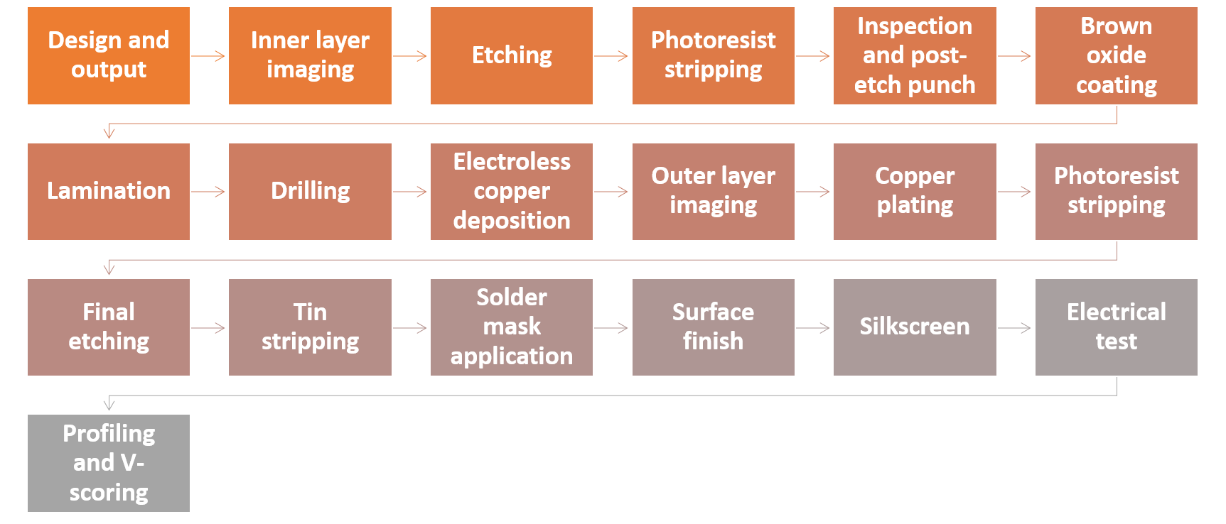
PCB Manufacturing steps

Slide 15
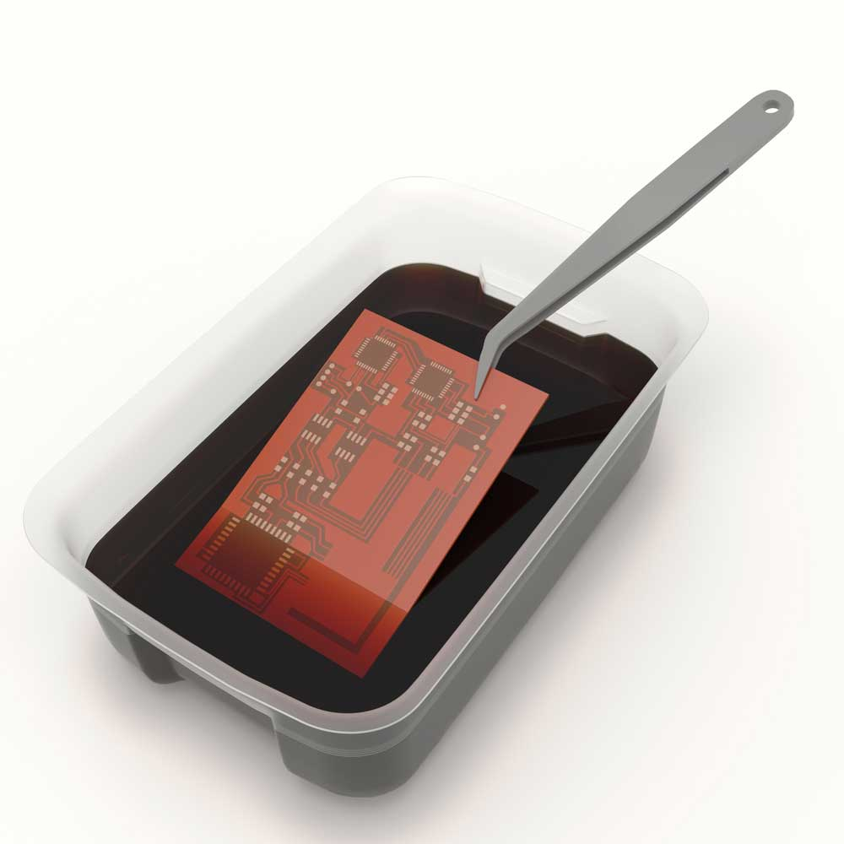
Etching
The itching is the core of the PCB manufacturing process, based on subtractive method which involves removal of copper from undesirable areas in order to achieve the desired circuit pattern.

Slide 16
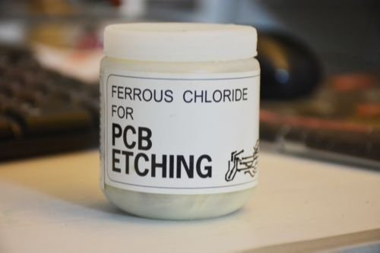
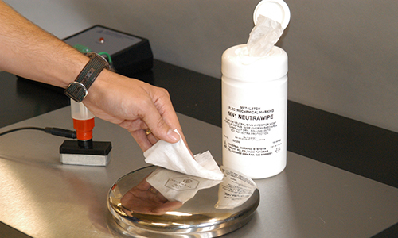
The oldest and still used etchant is ferric chloride, which oxidizes copper to cuprous chloride from the areas which are not protected by etch resist.
Several other chemicals such as ammonium persulphate, chromic acid , cupric chloride and alkaline ammonia have been used as etchants, with each of them having its own advantages and disadvantages.

Slide 17
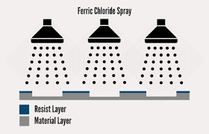
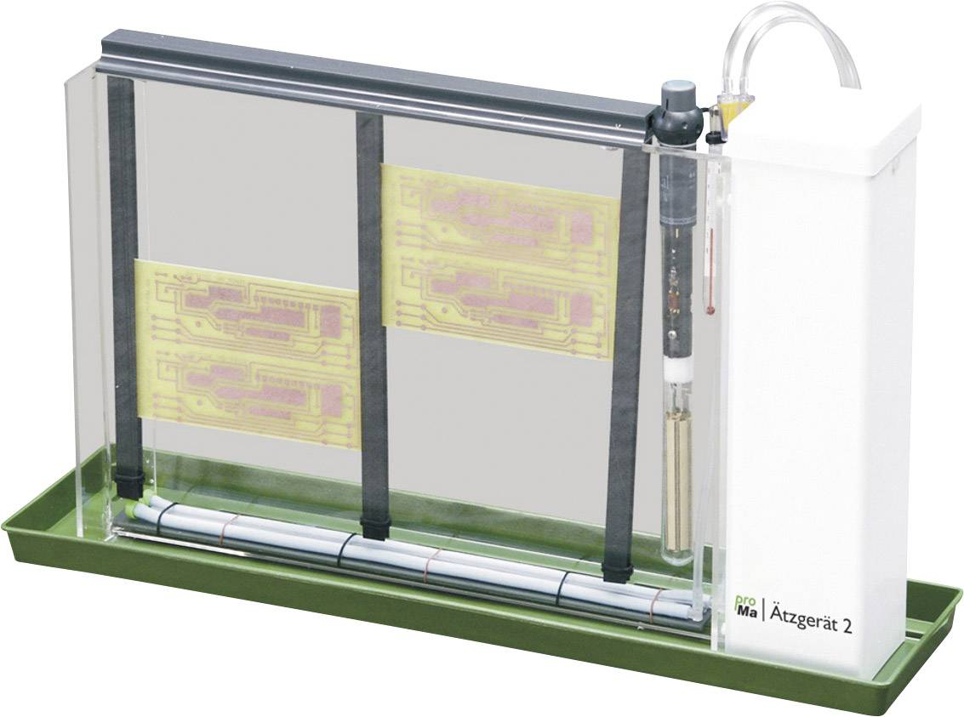
Etching is usually done by the immersion, bubble, splash or spray method.
The spray etching method is the most comman.
In this process, the etchant is pumped under pressure from a tank to the nozzles which splash the etchant on the board.

Slide 18
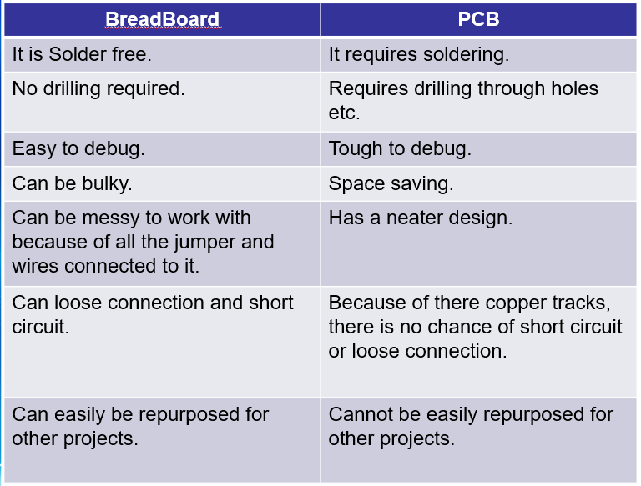
Difference between Breadboard and PCB

Slide 19
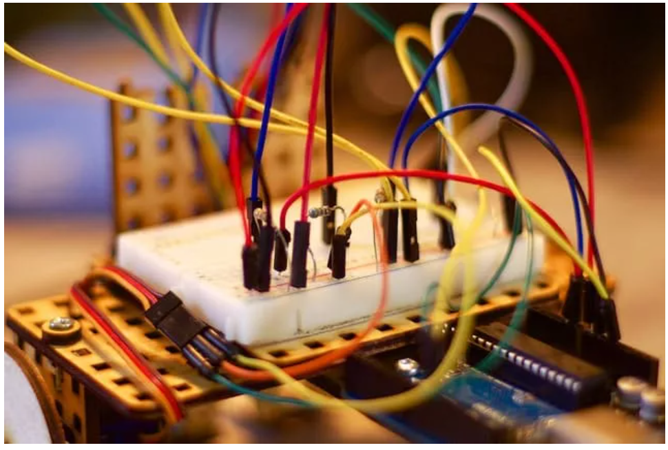
Suitability
When to Use a Breadboard?
You would use a breadboard mostly for experimenting with connections and circuits. Because the board is not permanent, it allows you to move circuits around without damaging the board. However, because it is not a permanent board, the current capacity is minimal and is best used as a pre-step before developing the actual PCB.

Slide 20
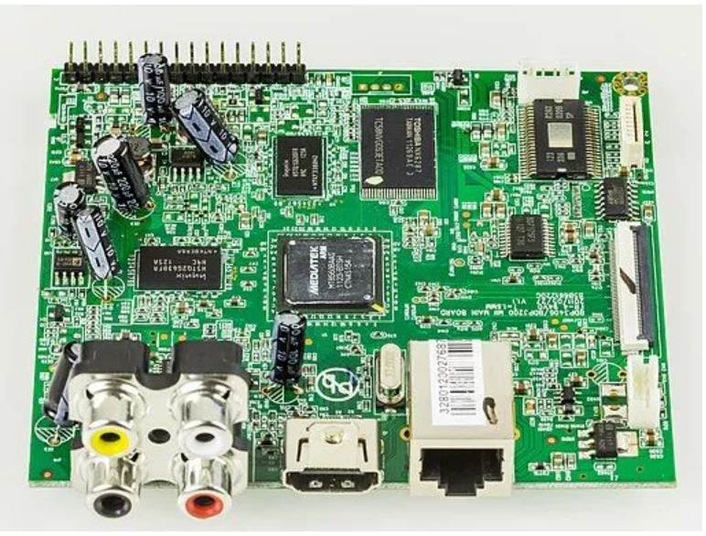
Suitability
When to Use a PCB?
You would use a PCB for the actual electronic device. After you test out the breadboard and find the design best suited for your project, you would then develop that into a PCB. The PCB is a permanent device in electronics because of the soldering required. You would use a PCB to run your electronic project.

Slide 21
ANY QUESTIONS??

